Slide 1

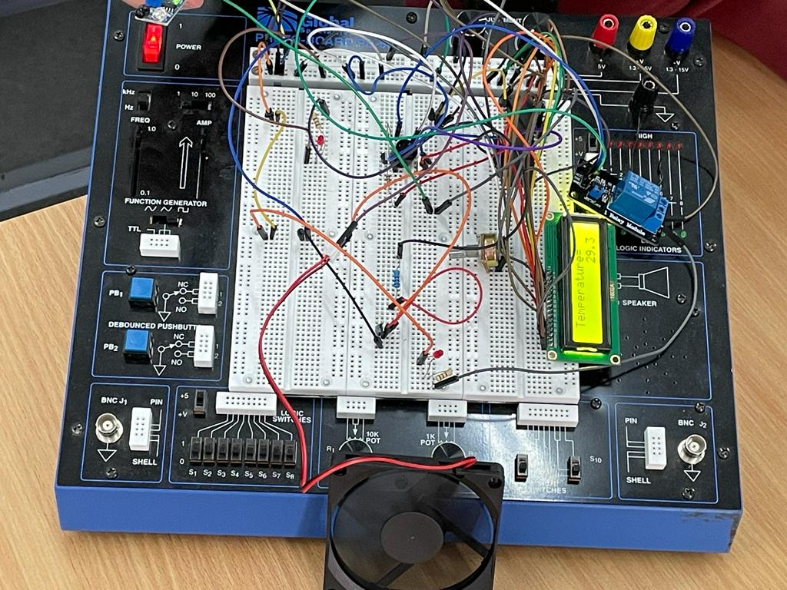
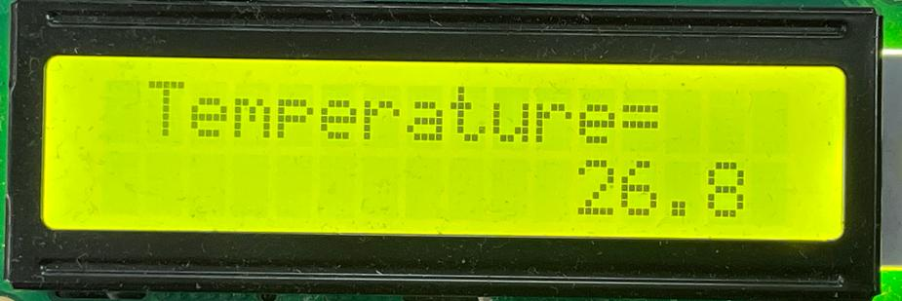
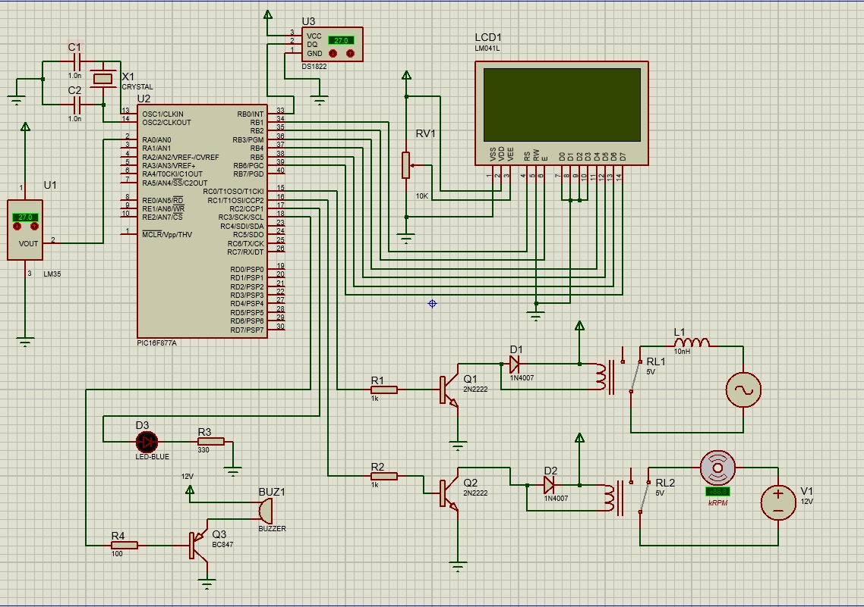
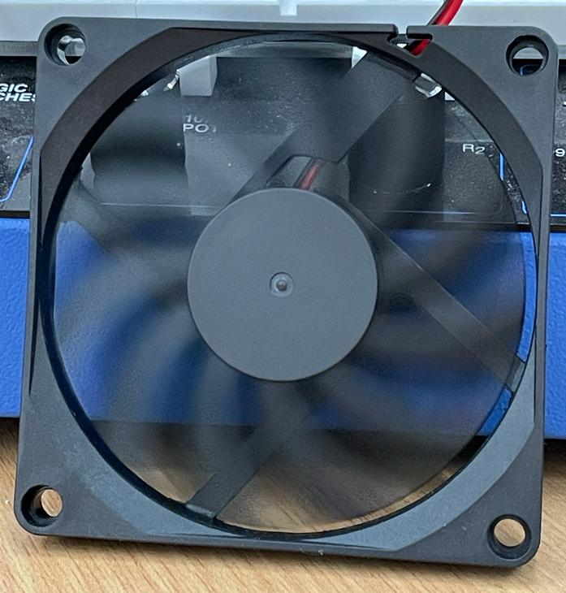
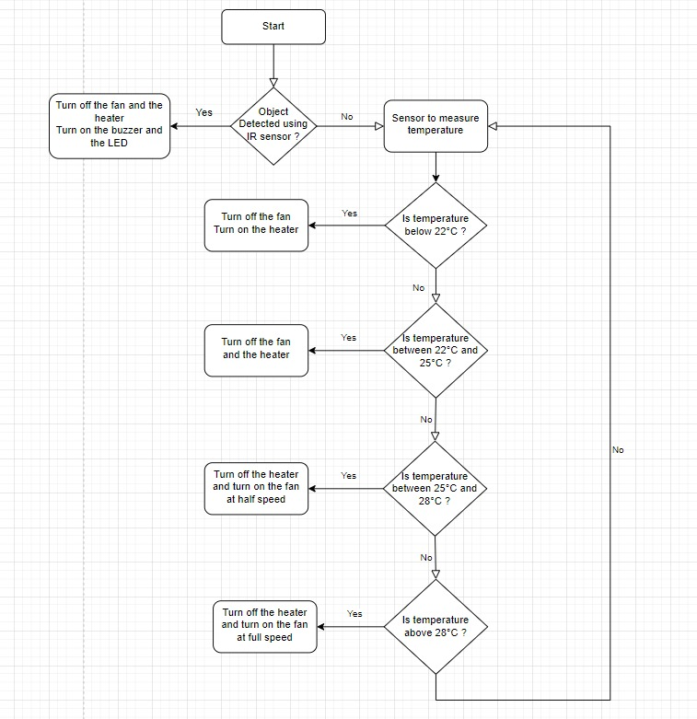
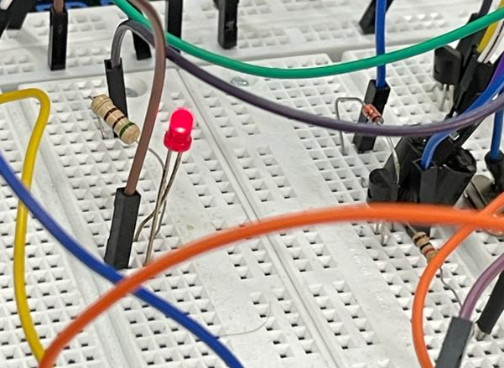
Smart Conditioning System
S. Mehyar, N. Saleh, K. Farwagi
Supervisor: Dr. Belal Sababha
Embedded Systems Final Design Project, Fall 2022
King Abdullah II School of Engineering
Princess Sumaya University for Technology
Introduction
In this project, we are presenting a smart conditioning system, which is capable to provide the ideal cooling or heating conditions depending on the actual temperature. The system works on turning on or off a fan or a heater after reading the ambient temperature using the famous temperature sensor.
In addition, the system provides a smart feature that ensures that the safety of the user is in safe hands; this is applied by using an infrared sensor that turns on a buzzer and an LED if any object moves close to the system. In this way, the LED and the buzzer will work together as an alarm system.
Results
We were able to implement the project and output real-life results, taking into consideration the human interaction, and its effects on the conditioning system components.
Figure 3: Top View.
The temperature sensor measures the current temperature. After that, a series of actions are taken depending on the temperature measured by the sensor. These actions include, turning on or off the DC fan or heater. However, if the infrared sensor detects a moving object, it will provoke the system to turn off and an alarm system will start by turning on a buzzer and an LED.
Figure 4: Temperature Sensor.
Figure 5: DC Fan turns on when temperature is high.
Figure 6: LED and buzzer are on after a close object being detected by the infrared sensor.
Design
For implementing this project, plenty of hardware instruments were used; including PIC16F877A, a crystal oscillator, a temperature sensor, an infrared sensor, an LCD, a DC fan, a heating element, a buzzer, an LED, in addition to resistors (some of which are potentiometers), transistors and an electromechanical relay.
Figure 1: Electrical Design.
Figure 2: Software Design.
Conclusion
In conclusion, the aim of this project is to develop the idea of automatic temperature monitoring, an application that can be implemented in the following years to provide a green environment using sensors that can aid the process of smart conditioning construction. Finally, our project works on offering the absolute safety conditions, whether in houses, companies, or even larger working areas such as factories and airports.

